Slide 1
Next step

Slide 2
Song 000
Song 001
Song 002
…
Song 007
Select song
Song 008
…
Song 015
Change instrument
Song 016
…
Reset position

Slide 3
Pimironi PICO
Audio
Audio Out
I2S interface via GPIO
Raspberry PICO
(MIDI USB host)
Novation Launchpad mini
MIDI via USB
reset position(GPIO 13)
stay in position / progress position (GPIO 14)
stay in position / progress position (GPIO 15)

Slide 4
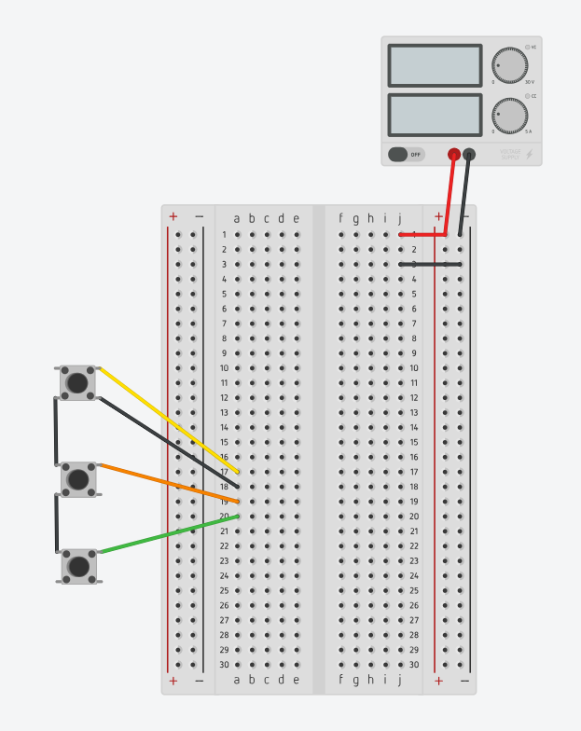
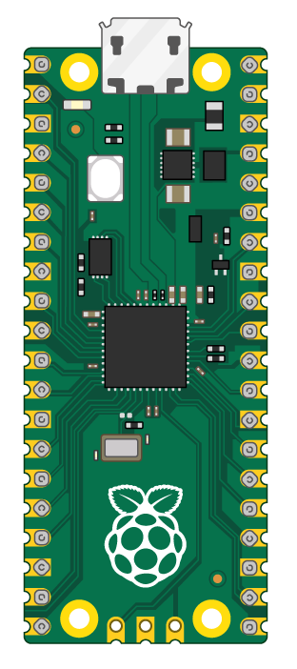
5V DC
1A
USB to Launchpad
Stay / progress
GND
GND
Stay / progress
GND
Reset position

Slide 5
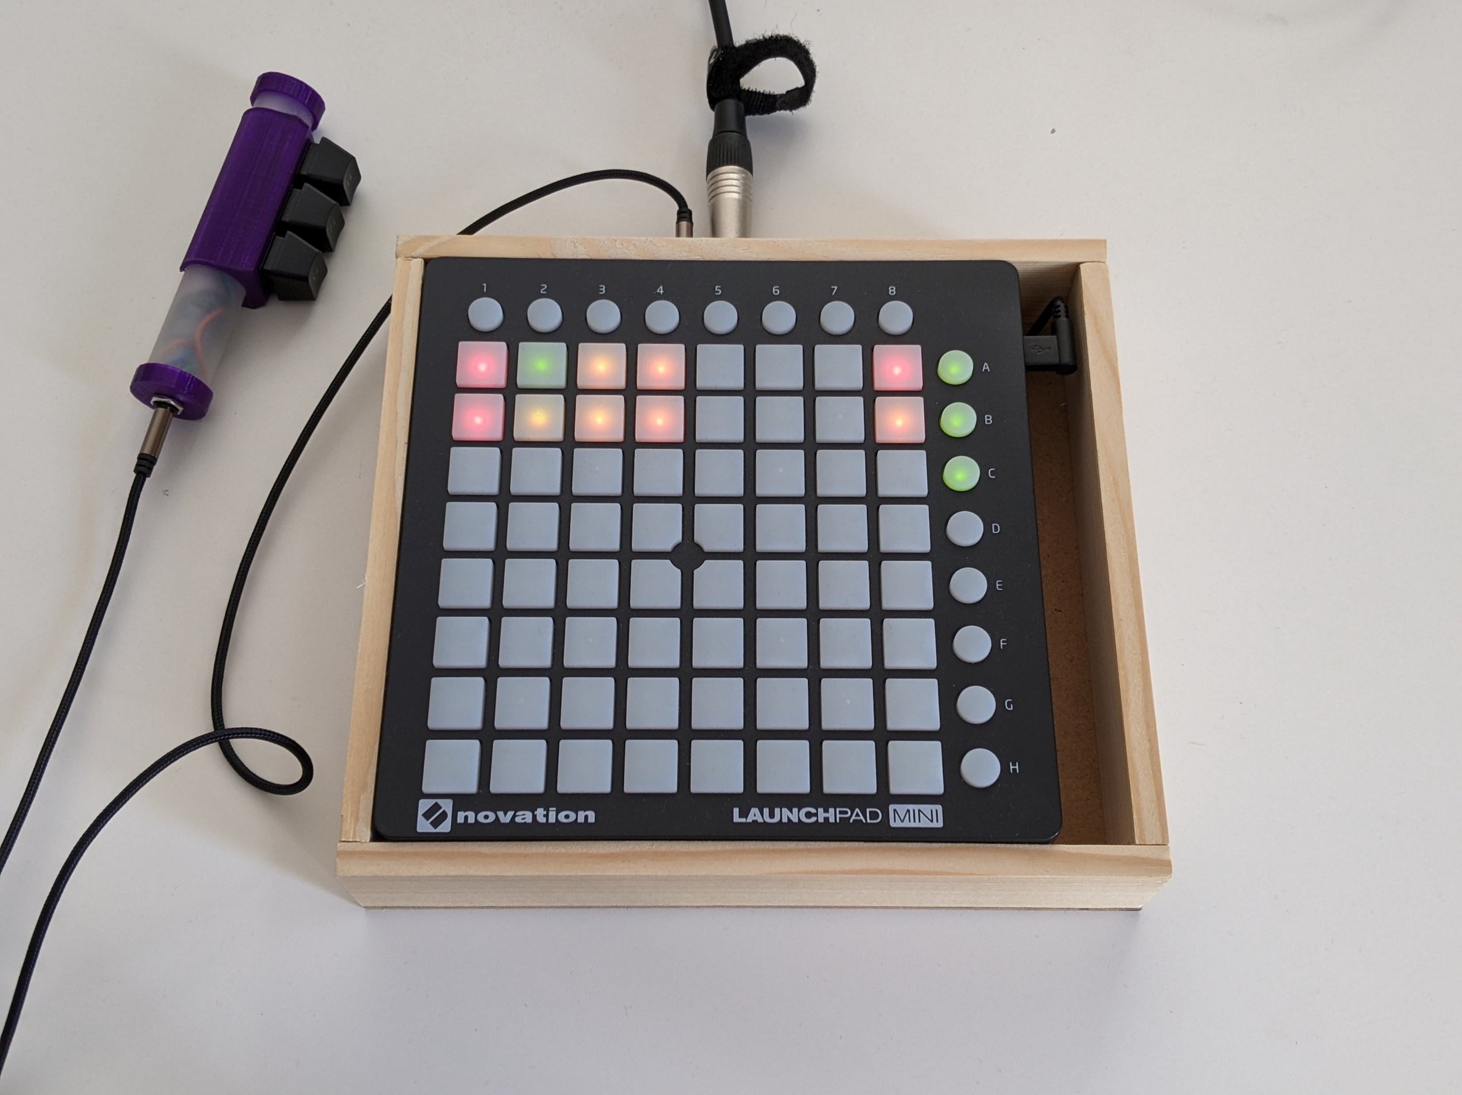
TRRS cable for external optional controller
Audio out (line out)
Novation Launchpad mini
external optional controller

Slide 6
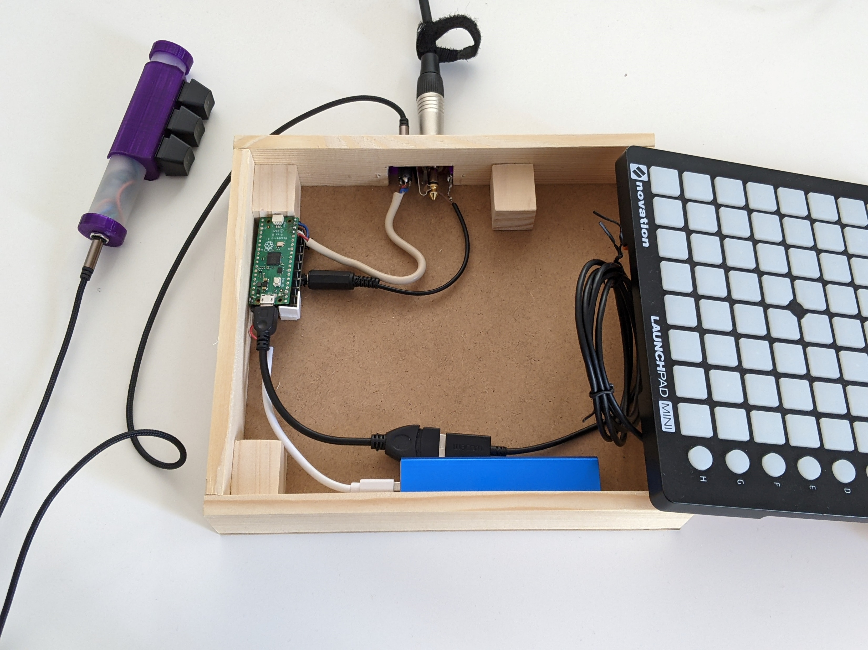
GPIOs for external controller
Novation Launchpad mini
Audio out (line level)
Raspberry PICO + Pimironi pico audio hat
Micro USB to USB A female, USB A male to USB B male
Power bank, 5V 1A

Slide 7
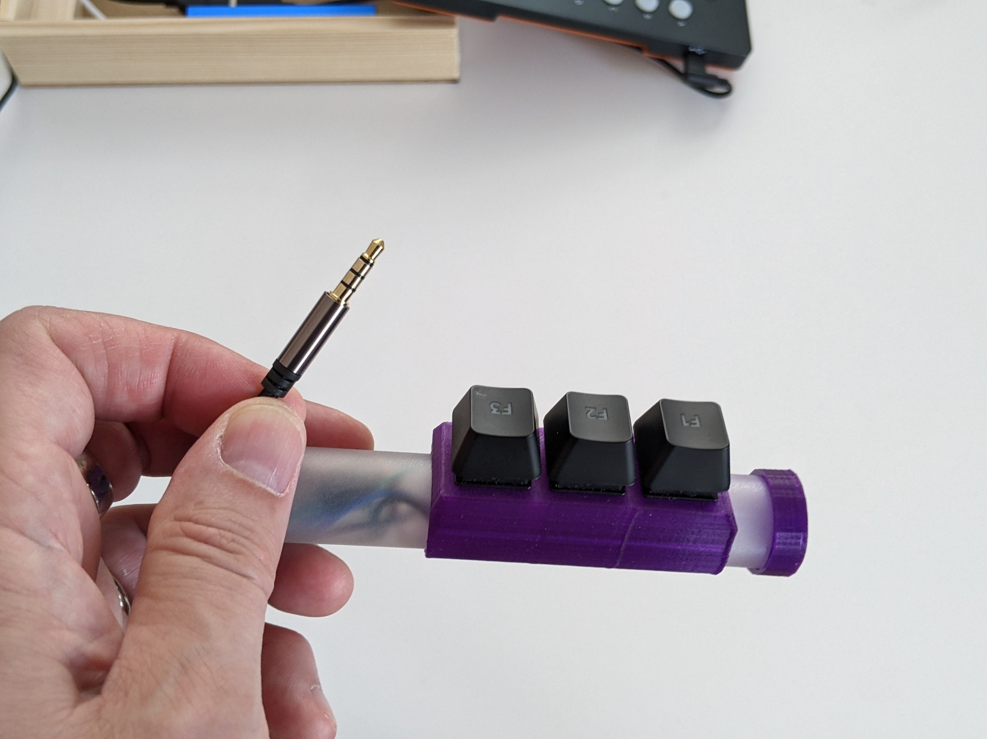
TRRS cable for connection to 3 GPIOs + GND
Recycled PC keyboard switches and key caps
PVC tube + 3D printed keys holdster

Slide 8
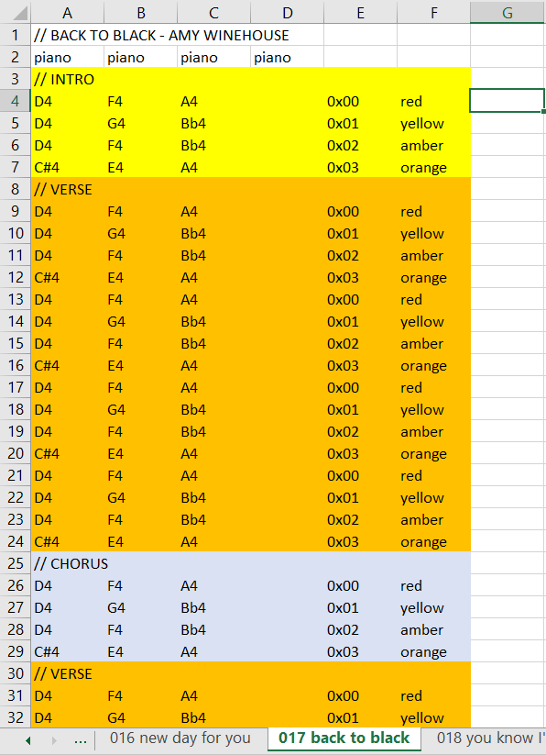

Slide 9
0x00
0x01
0x02
0x03
0x04
0x05
0x06
0x07
0x10
0x11
0x17
0x20
0x27
0x30
0x40
0x50
0x60
0x70
0x71
0x72
0x73
0x74
0x75
0x76
0x77

Slide 10
000
001
002
003
004
005
006
007
Select song
008
009
015
016
023
024
032
040
048
056
057
058
059
060
061
062
063

Slide 11
